Slide 1
Team Shi
SudokuPlus

Slide 2
Team Members:
Mitchell Baer – Logic/Unit Testing
Matt Dean-Hall - GUI
Eric Celerin – Server/User Thread/GUI

Slide 3
Sprint 1:

Slide 4
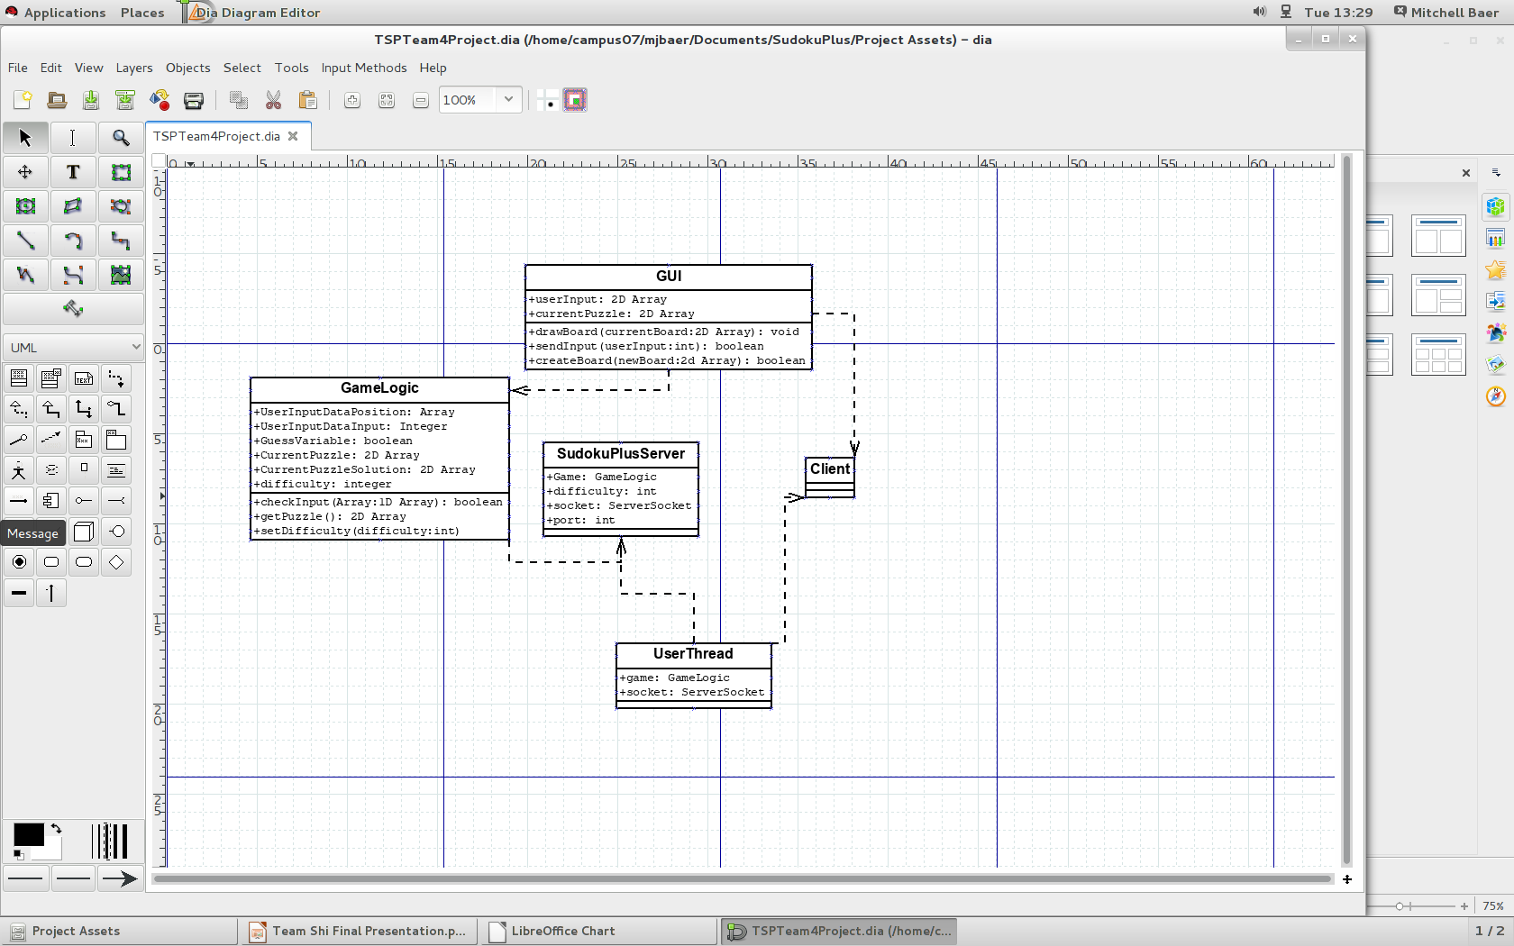

Slide 5
Good:
Developed a good plan (Diagrams) – When we were designing our application, we spent a good deal of time figure out what exactly we needed to do to stay busy and what was important versus what could be added in if we needed to, etc.
Finished all of base code (GameLogic) – With all applications, a good base is fundamental. The GameLogic code is referenced a lot throughout all of the code, so if there was a small bug deep down, it needed to be fixed.
Made better goals for Sprint #2. - We figured out what worked and what didn't and improved on that.

Slide 6
Bad:
Git-hub – Only one member had experience.
Timing – Didn't dedicate very much time towards actual programming. - We deemed it important to develop a good plan in order to make sure the application was the best it could be in the given time. Planning took a week, so now we only had 5 weeks of actual development time.
Minor bugs to work through with getting everyone's code working together – Making sure variables were correct, get/set methods, etc. All had to work together.
Burn-down Chart – We all don't have much experience with group projects, so we over budgeted everything, so our burn-down chart looks a little different from most peoples.

Slide 7
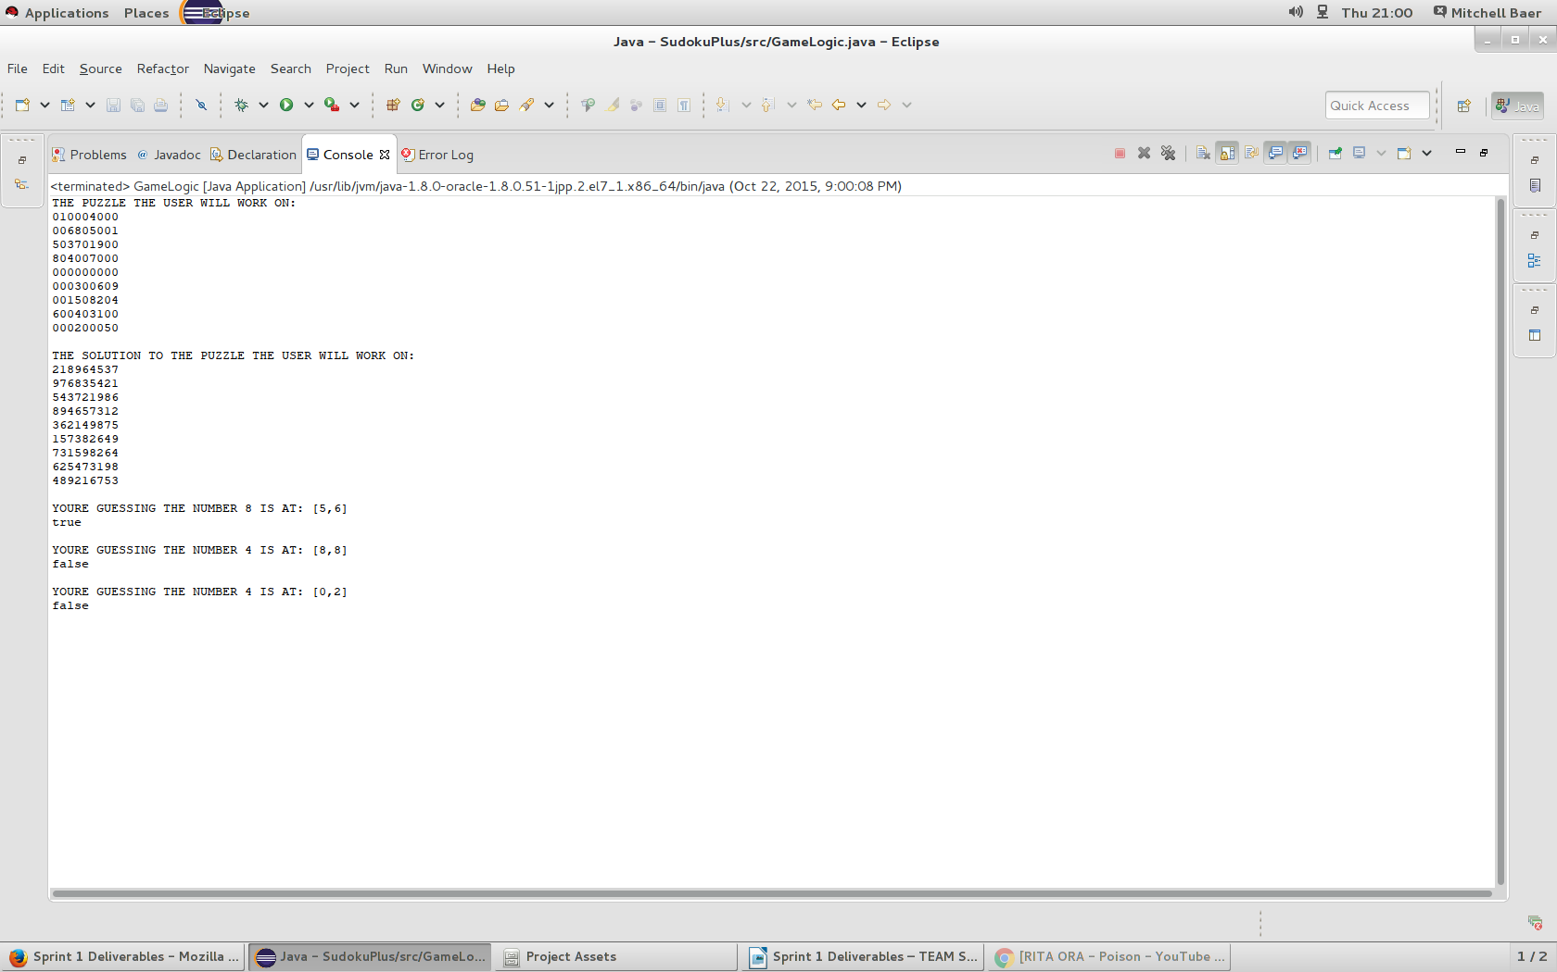

Slide 8
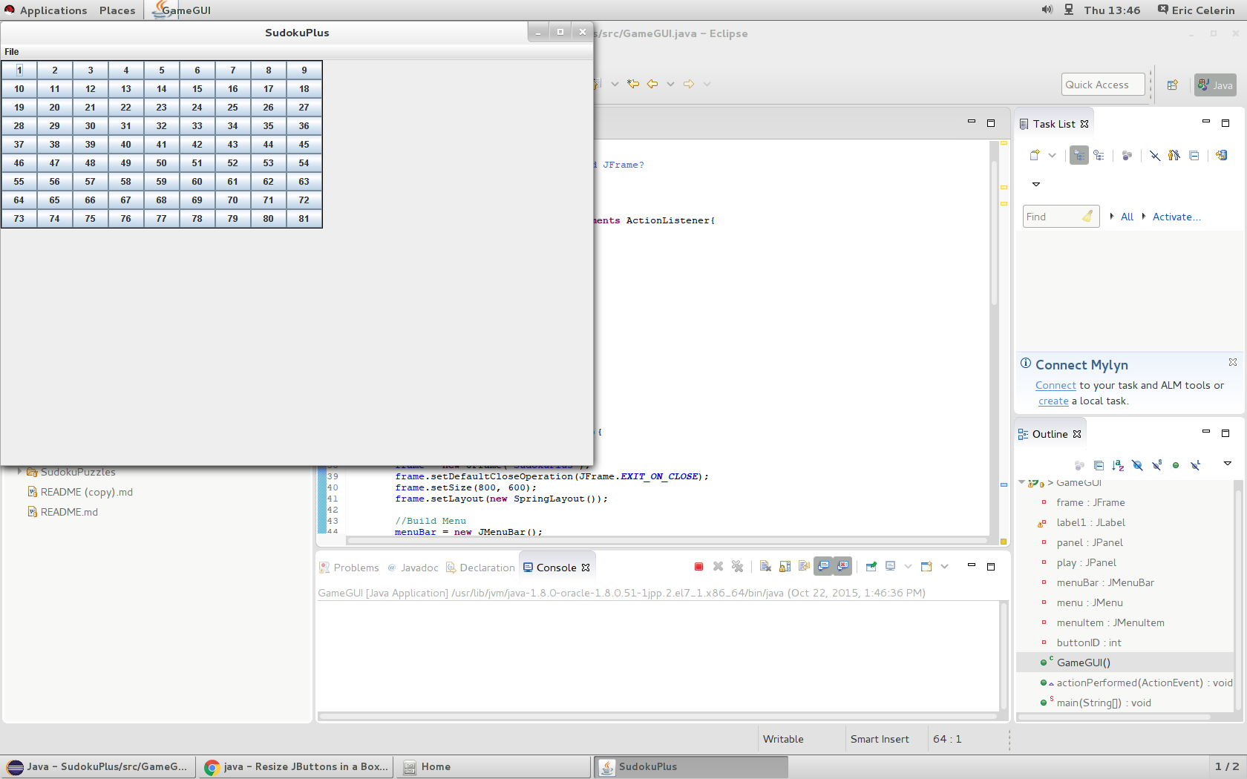

Slide 9
Burndown Chart for Sprint 1:

Slide 10
Sprint 2:

Slide 11
Good:
Working Application – By the end of Sprint 2, we had an application that was playable. Some features were missing, but it could be interacted with.
Increased productivity – After Sprint 1 and having set goals, our productivity was way more than the first sprint. Partially because we had more time, but mostly because we had goals in mind.
Added features – Remote server, incorrect guess, highlighting numbers, working GUI, etc.

Slide 12
Bad:
More minor bugs – We added a lot of code in Sprint 2, so there were a few minor GUI bugs to iron out along the way. Some of them are still in there.
Clock – Our application utilizes the clock. If this clock is off, things won't update in time (too slow or too fast), etc. It also has online capabilities, so the clock serves an important role there. It pings the server for updates.
Changed focus a bit – We had to figure out what we needed to get done and what couldn't get done, so we changed our focus a little bit.

Slide 13
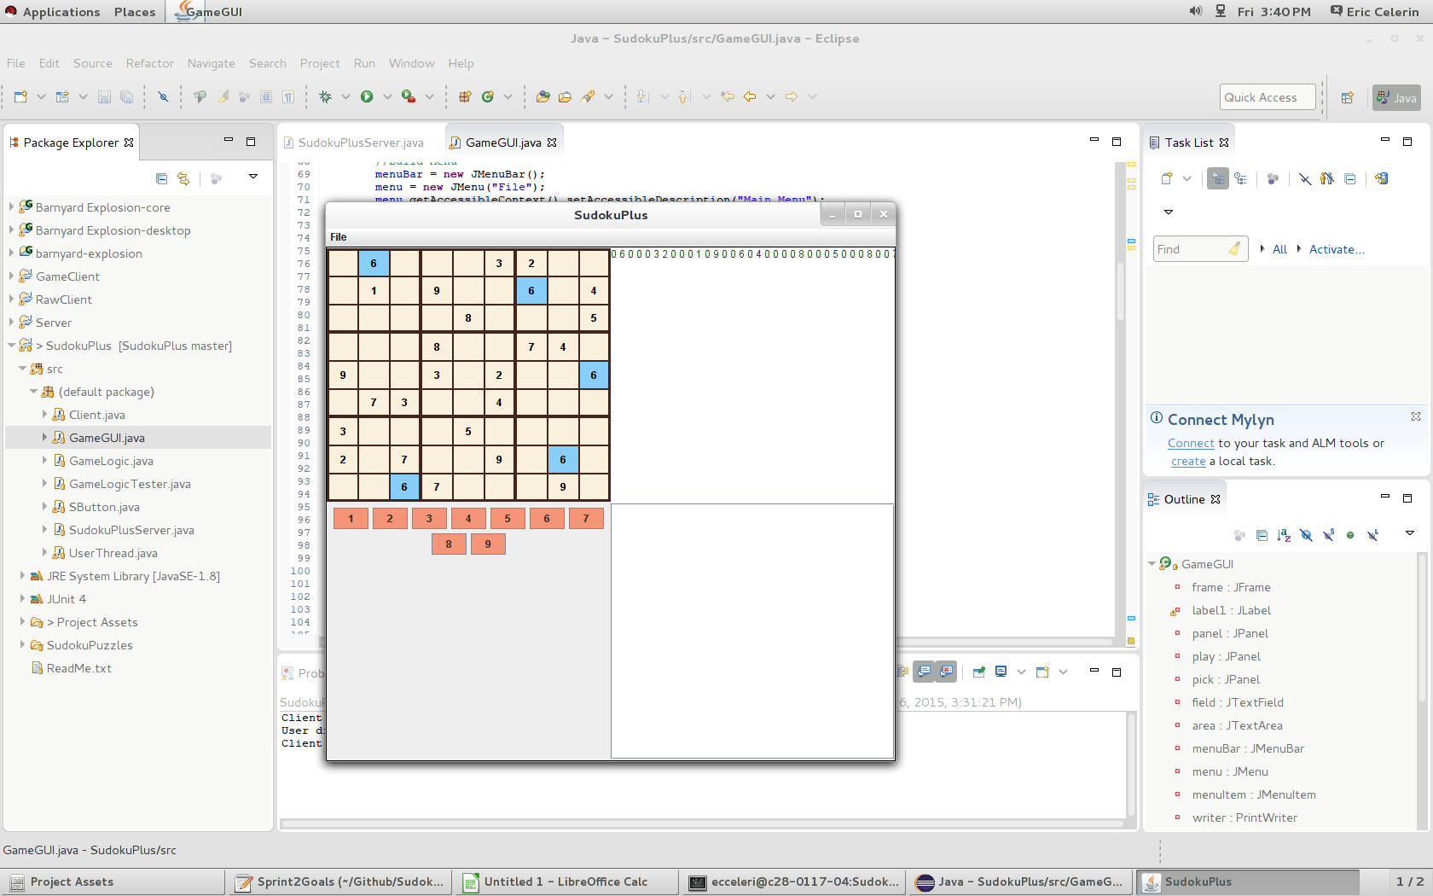

Slide 14
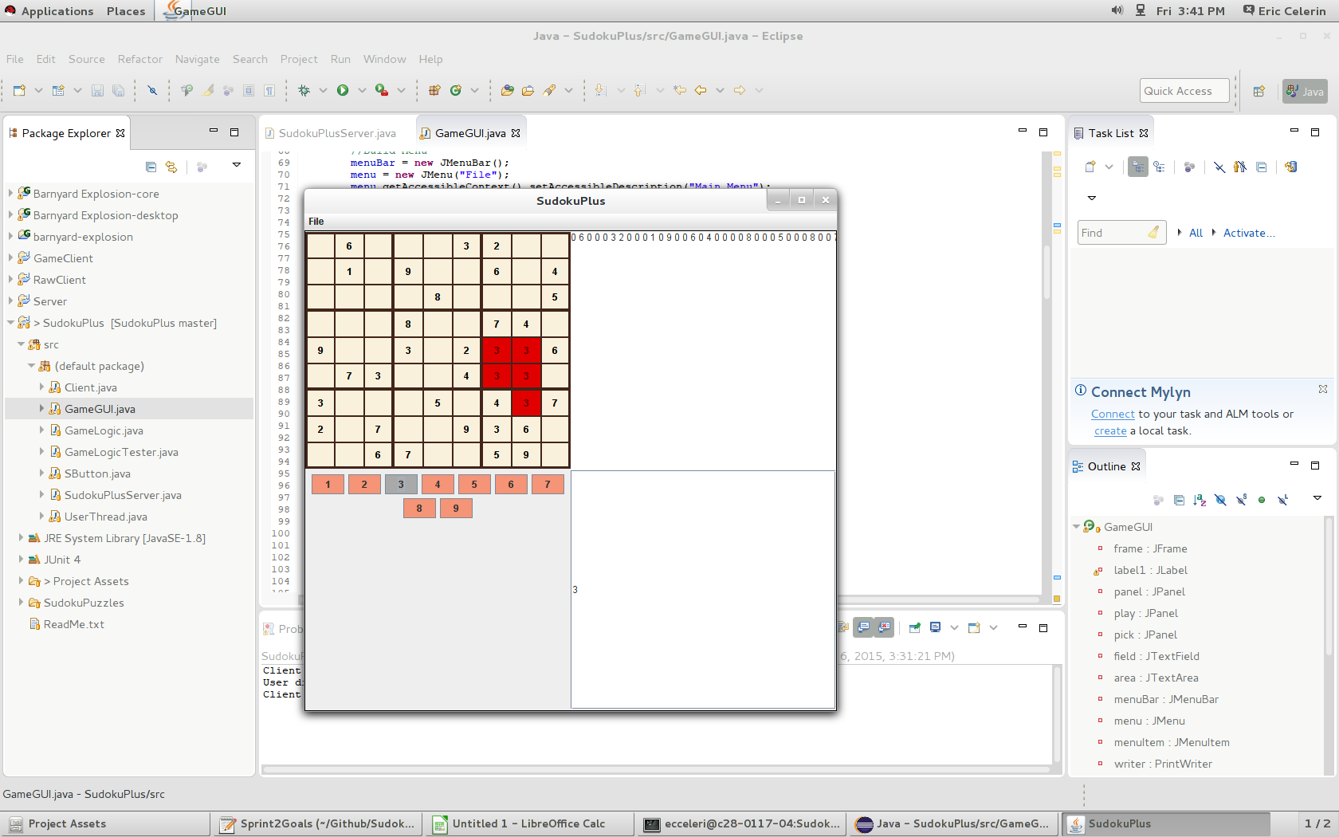

Slide 15
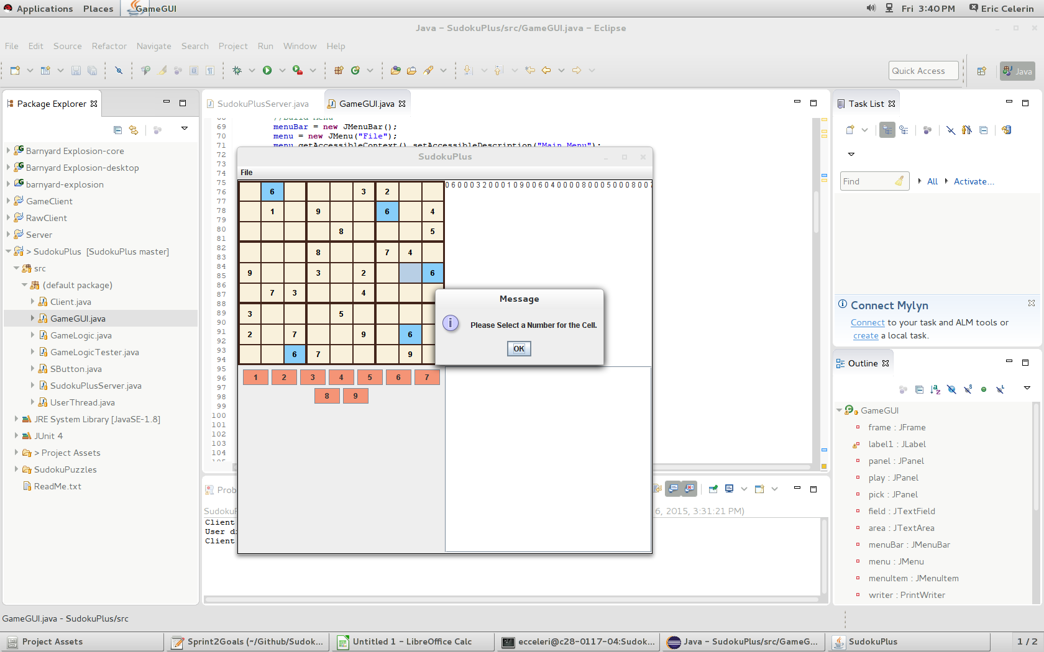

Slide 16
Burndown Chart for Sprint 2:

Slide 17
Unit Tests:
We took advantage of J-Unit for our unit tests.
As opposed to what was seen previously, these are actual unit tests.
One thing we had to keep in mind: For most of our tests, we had to check whether or not they failed them. By failing them, they were in fact passing the tests, so it took a different way of thinking to make sure they were set up correctly.
DEMO OF UNIT TESTS

Slide 18
Sprint 3:

Slide 19
Good:
Even more added features – This final sprint was the one where we spent most of the time adding features. Timer, win condition, usernames, etc.
More Unit tests – Had to add more methods to the GameLogic, so that meant more unit tests could be written. Ensured the code was working correctly still.
Increased productivity – Like sprint 2, we increased our productivity even more so that in sprint 2. We got more done and optimized a few different things.

Slide 20
Bad:
Serious Git Issue – Other than initially learning git, we only had one disaster and it happened this sprint. Almost lost hours of work. Had to fix the repo and revert it back to a previous version. Wasn't too bad fixing, but was definitely scary.
Bugs – Nothing really serious here. These were expected. When you add a feature, very rarely do they work the first time over. Just took some minor tweaking to get all of the code running together again.

Slide 21
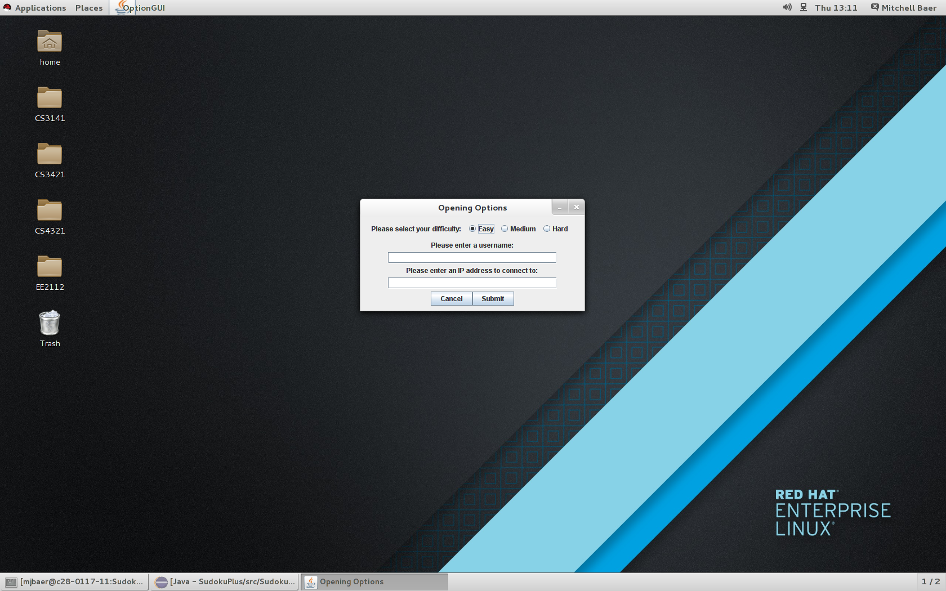

Slide 22
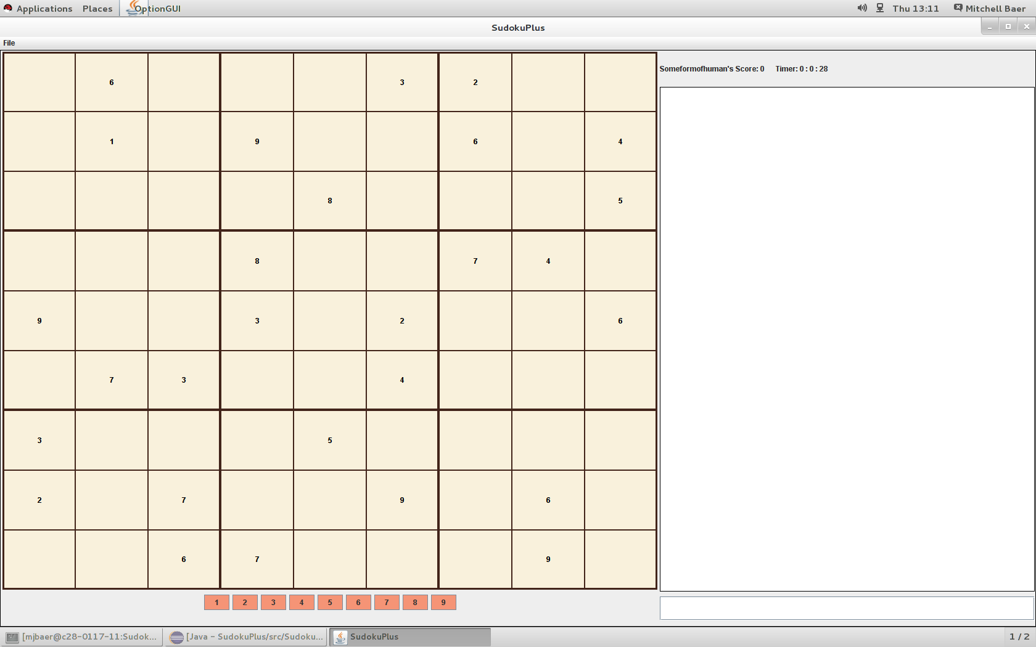

Slide 23
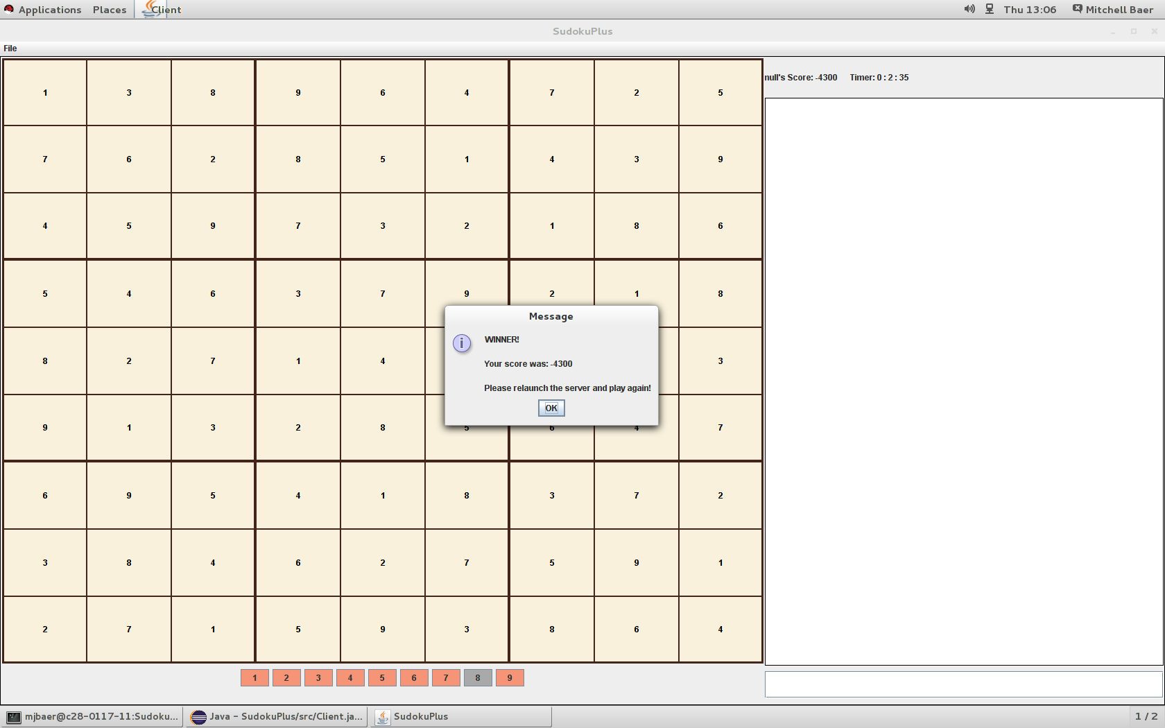

Slide 24
Burndown Chart for Sprint 3:

Slide 25
Bugs:

Slide 26
Cool Features:

Slide 27
SCRUM:

Slide 28
Finished Product Demo

Slide 29
Questions?

